Slide 1

Human Speech Production

Slide 2
Contents
Hearing
Auditory Models
Speech Perception

Slide 3
Hearing

Slide 4
Hearing
Human Hearing Mechanism
Anatomy of the Auditory System
The auditory system includes the outer ear (pinna), middle ear (eardrum and ossicles), inner ear (cochlea), and auditory nerve pathway to the brain.
The cochlea plays a crucial role in transforming sound vibrations into neural signals
Importance of Acoustic Analysis
The brain processes auditory signals through complex neural networks, distinguishing speech sounds based on frequency, intensity, and temporal patterns.

Slide 5
Hearing
Speech Perception in Humans
Speech Processing Pathway:
Incoming speech signals are processed through the auditory cortex, where phonemes (distinct speech sounds) are identified and assembled into words and sentences.
Higher-level cognitive processes integrate linguistic context, semantics, and prior knowledge to comprehend spoken language.
Cognitive Factors:
Attention, memory, and language proficiency influence how humans perceive and understand speech.

Slide 6
Hearing
Speech Perception in Humans
Speech Processing Pathway:
Incoming speech signals are processed through the auditory cortex, where phonemes (distinct speech sounds) are identified and assembled into words and sentences.
Higher-level cognitive processes integrate linguistic context, semantics, and prior knowledge to comprehend spoken language.
Cognitive Factors:
Attention, memory, and language proficiency influence how humans perceive and understand speech.

Slide 7
Auditory Models

Slide 8
Auditory Models
Introduction
Overview of Auditory Processing:
Auditory models aim to simulate the human auditory system's function, including sound perception, frequency analysis, and temporal processing.
They play a crucial role in understanding how the brain processes sound and facilitates speech recognition, music analysis, and biomedical engineering applications.
Role of Machine Learning:
Machine learning provides tools to develop computational models that mimic aspects of auditory processing, enabling tasks such as sound classification, source separation, and feature extraction.

Slide 9
Auditory Models
Auditory Models and Machine Learning
Integration of machine learning in auditory processing
Advantages of using machine learning for auditory tasks.
Automation of feature extraction and classification tasks.
Types of machine learning algorithms used
Supervised learning (e.g., SVM, neural networks).
Unsupervised learning for clustering and segmentation.

Slide 10
Auditory Models
Dataset and Preprocessing
Description of the dataset used
Example: Audio recordings of speech and music.
Preprocessing steps
Audio feature extraction using Librosa:
Mel-Frequency Cepstral Coefficients (MFCC).
Spectrogram analysis.
Data normalization and cleaning for machine learning tasks.

Slide 11
Auditory Models
Auditory Feature Extraction
Detailed explanation of auditory features:
Mel-Frequency Cepstral Coefficients (MFCC):
Extraction of spectral features.
Capturing frequency information in a log-scale.
Spectral features:
Spectral centroid, bandwidth, and rolloff.
Energy-based features for audio characterization.

Slide 12
Auditory Models
Auditory Models
Gammatone filterbank:
Simulation of cochlear filtering in the auditory system.
Auditory nerve models:
Modeling of neural responses to auditory stimuli.

Slide 13
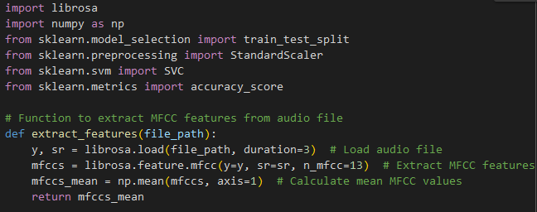
Auditory Models
Building Auditory Models with Python
Use of Librosa library for audio processing:
Loading audio files and extracting features.
Visualizing audio signals and spectrograms.
Example code snippets for auditory feature extraction and model development.

Slide 14
Auditory Models
Practical Assignment
Task: Classify audio samples into speech or music categories.
Dataset: Collect a sample audio dataset containing speech and music recordings.
Steps:
Preprocess the audio data using Librosa.
Extract auditory features (e.g., MFCC) from the audio files.
Build and train a machine learning model (e.g., SVM) for classification.
Evaluate the model's performance using accuracy metrics.

Slide 15
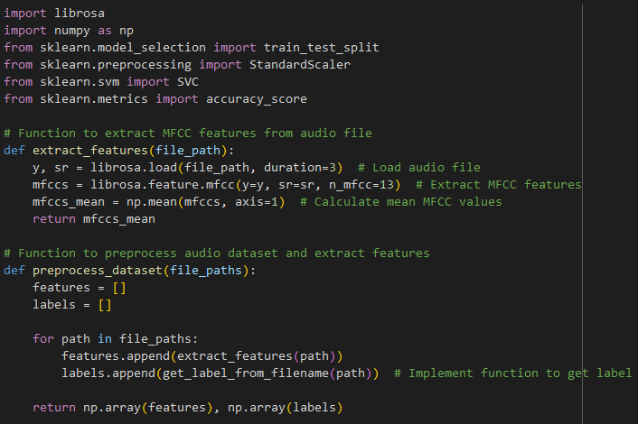
Auditory Models
Solution

Slide 16
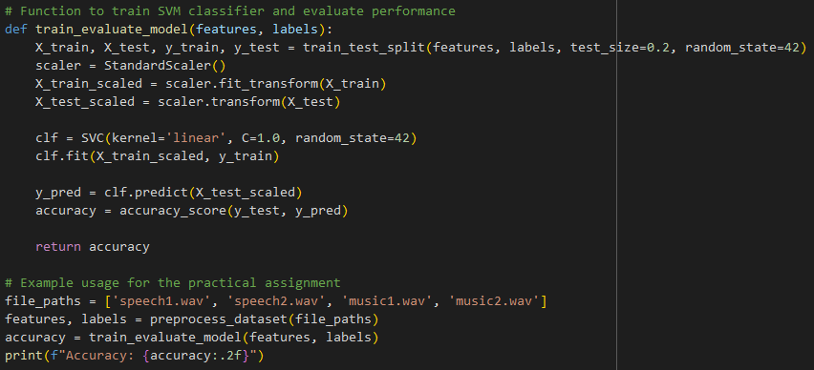
Auditory Models
Solution

Slide 17
Speech Perception

Slide 18
Speech Perception Fundamentals
Basics of Speech Perception
Speech perception involves the process of interpreting and understanding spoken language.
The human auditory system plays a crucial role in recognizing and processing speech sounds.
Phonetics studies speech sounds and linguistic units such as phonemes (distinct units of sound) and prosody (intonation, rhythm, and stress in speech).

Slide 19
Speech Perception Fundamentals
Speech Feature Extraction
Mel-Frequency Cepstral Coefficients (MFCCs)
Represent the short-term power spectrum of sound, capturing phonetic information compactly.
Prosodic Features
Pitch: Frequency of speech waveform, indicative of voice tone and emotion.
Intensity: Amplitude of speech signal, providing information about stress and emphasis.
Duration: Timing of speech segments, influencing rhythm and timing perception.

Slide 20
Speech Perception Fundamentals
Speech Recognition Models
Hidden Markov Models (HMMs)
Used for acoustic modeling and sequence alignment in traditional speech recognition systems.
Deep Learning Models (e.g., LSTM, Transformers)
End-to-end neural network architectures that directly map audio features to text sequences, achieving state-of-the-art performance in automatic speech recognition (ASR).
Training Pipelines
Acoustic modeling: Capture phonetic information from audio features.
Language modeling: Incorporate linguistic context to improve recognition accuracy.
Decoding: Align audio features to the most likely sequence of words or phonemes.

Slide 21
Speech Perception Fundamentals
Building Speech Perception Models
Implementation in Python:
Load and preprocess audio files, extracting MFCCs and prosodic features.
Visualize and analyze extracted speech features to understand their significance.
Example code snippets for feature extraction and transformation into input data suitable for machine learning models.

Slide 22
Speech Perception Fundamentals
Integration of Speech Features with ML Models
Implementation in Python:
Transform audio features (MFCCs, prosodic features) into input vectors for neural networks or other classifiers.
Train and optimize machine learning models (e.g., LSTM, CNN) using labeled speech data.
Evaluate model performance using metrics like accuracy, Word Error Rate (WER), and Confusion Matrix.

Slide 23
Speech Perception Fundamentals
Practical Assignment
Task: Develop a speech recognition system using a provided speech dataset.
Dataset: Include audio recordings with corresponding transcriptions or labels.
Steps:
Preprocess audio data: Extract MFCCs and prosodic features from audio files.
Implement a speech recognition model: Choose an appropriate ML algorithm (e.g., LSTM) and train it on the dataset.
Evaluate model performance: Use test data to assess recognition accuracy and analyze error patterns.
Discuss potential improvements: Explore ways to enhance model robustness and accuracy.

Slide 24
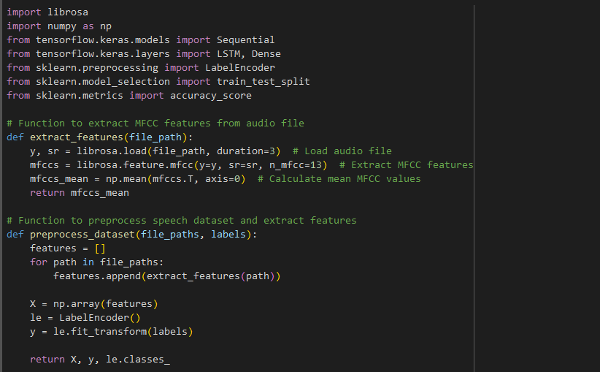
Speech Perception Fundamentals
Practical Assignment (Solution)

Slide 25
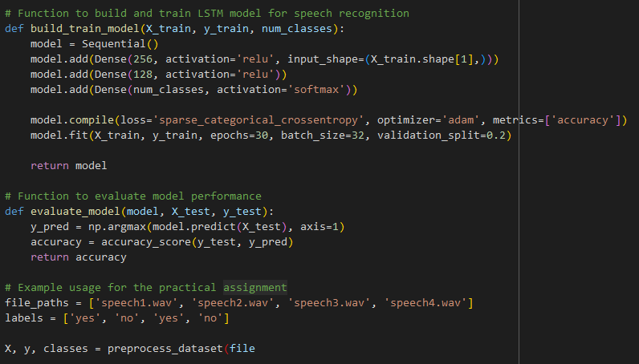
Speech Perception Fundamentals
Practical Assignment (Solution)

Slide 26
Q & A

